Slide 1

WAIŪ– A Celebration Of Sharing Happiness

Slide 2








WAIŪ : Mission, Vision & Values
Mission:
To become a global leader in hospitality industry, realizing pioneering advancements in established services, to accomplish growth of both our partners & customers
Vision:
WAIŪ is dedicated to provide modern & innovative solutions to our hospitality partners, via introduction of technology evolution in their offerings and opening avenues of inspiring new business horizons.
Values:
Innovation through Leadership : To spearhead hospitality experience uplift, Consistently
Modernization & Elegance : To develop ultramodern hospitality business solutions
Focus & Evolution : Relentlessly strive to improve business value through performance

Slide 3
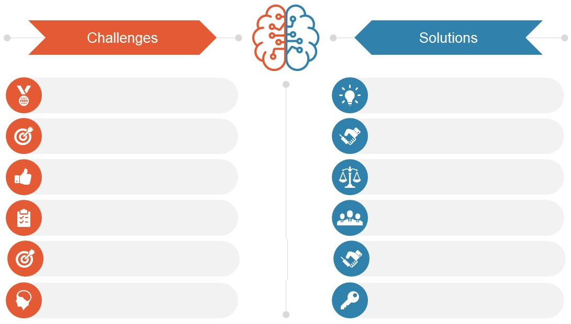
Industry Challenges & Solutions
Lack of options to share or gift a drink to friends or family
Unique & unmatched opportunity
to share/offer drink to anyone, anywhere
No socializing platforms in restaurant premises
Innovative technology driven platform for B2C & C2C interaction
Low margins of operation when utilizing traditional delivery models
Higher benefits & financial control with reduced expenses
No avenues for cost effective event arrangement or broadcast
Impactful means of event
organization & rapid marketing
Obligation of menu costing without future benefits
Use based costing, with exciting offers & guaranteed cashback
No tangible advantages of higher spend & lockdown sensitivities
More value for money & standardization of health & wellness

Slide 4
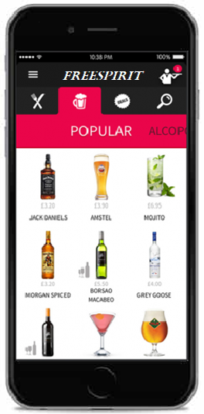








Product & Features
Gift a Friend
Gift or share a drink of choice to your beloved ones e.g. Corporates, Family & Friends & colleagues
Broadcast & Live Streaming
Watch live shows & virtually share special moments with the dear ones & staff training demonstrations
Offer a New Friend
Offer service will be availed at merchant establishment with other groups or individuals
Eat Now, Pay Later
Service for the our bank partner’s privileged customers
Purchase For Self
Instant cashback facility for regular customers to avail restaurant services
Events & Gaming
Promote corporate events, interactive games for in-house patrons
Payments & Point Wallet
Express true feeling of sharing & gifting with points instead of money
Food Delivery
Break the dependency of service aggregators, with reduced expenses

Slide 5
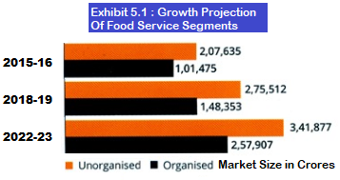
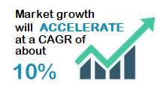
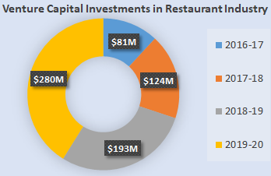
Market Research Convergence
Source: NRAI & FICCI / PwC, World Bank
Trend #1: Ethnic cuisine will increasingly be present in organized and hygienic set-ups
Trend #2: Food tech will continue to ‘organize’, driving increased focus on consumers, innovation & efficiency
Trend #3: Restaurants will increasingly focus on consumer engagement using technology
Trend #4: Health and wellness will continue to ride high on consumer preferences
Trend #5: Traditional packaging will make way for innovative food packaging
Trend #6: FMCG & entertainment industries will be major beneficiaries of rising disposable income

Slide 6
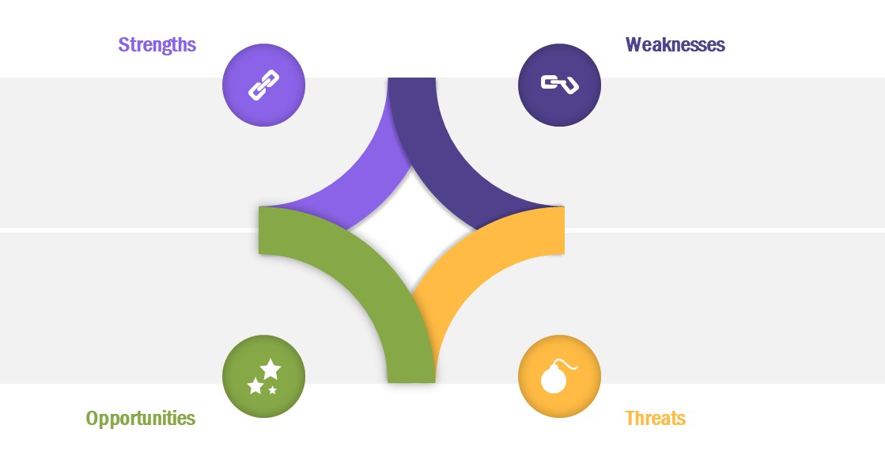
SWOT Appraisal
Unique service offerings
Cross-industry appeal e.g. Banking, M&E
Digital marketing enabler
Added value for money for customers
Changing FMCG mindset
Brand Establishment
Cross-Industry partnerships
Absence of support from Venture Capital or Institutional Investors
First mover’s advantage
Rising disposable income
Technology innovation & influence
Rising urbanization
International tie-ups
Expansion of existing service aggregators into hospitality business
Competition from global players
If we wont do it, someone else will

Slide 7





Value Proposition
New & relevant consumer base
Gift / Offer a Friend
Increased Digital Reach Through Acceptance & Branding
Bonus Media & Entertainment
Interactive Games & Entertainment
Higher Customer Retention
Enhanced Restaurant Search & Selection
Reduced Operating Costs
& Cross-Industry Marketing Network
Cost Effective Marketing
Socializing Channel
Corporate Events & Flexible Packaging for Social Occasions
Standard Multi City Platform
Indirect Revenue Source
Economical Delivery
Event Registration & Livestreaming

Slide 8

Minimum Viable Product – Q1 2021
Payments Gateway & Wallet
Express true feeling of sharing & gifting with points instead of money
Point Based Servicing
Interactive Games
Gift points to your family & friends
Socializing platform for restaurant guests
Gift A Friend
Broadcast & Livestream
Gift points to your family & friends
Entertaining event streaming to partner restaurants
Offer Points
Chatting & Notification
Offer points to a new acquaintance
Announcements & customer care

Slide 9
Project Plan – 6 Waves
Wave 06
April 2023
Expand in existing 10 Cities & explore additional scope
Target 3600 FL3 & 3.6 Lacs FL4 Customers in Each City
3600 FL3
36Lacs FL4
3000 FL3
30 Lacs FL4
Wave 05
October 2023
Expand in existing 10 Cities & explore additional scope
Target 3000 FL3 & 3 Lacs FL4 Customers in Each City
Wave 04
April 2022
Expand in existing 10 Cities & explore additional scope
Target 2400 FL3 & 2.4 Lacs FL4 Customers in Each City
2400 FL3
24 Lacs FL4
1800 FL3
18 Lacs FL4
Wave 03
October 2022
Expand in existing 10 Cities & explore additional scope
Target 1800 FL3 & 1.8 Lacs FL4 Customers in Each City
Wave 02
April 2021
Expand in existing 10 Cities & explore additional scope
Target 1200 FL3 & 1.2 L acs FL4 Customers in Each City
1200 FL3
12Lacs FL4
Wave 01
October 2021
Launch in 10 Cities
Target 600 FL3 & 60 thousand FL4 Customers in Each City
Company Registration : July 2020 - Complete
MVP Initiation : April 2021
Foundation Period : April-21 to September-21
RBI Approval & Launch : Oct 2021 (Wave 1)

Slide 10
Initiation & Growth Forecasts

Slide 11
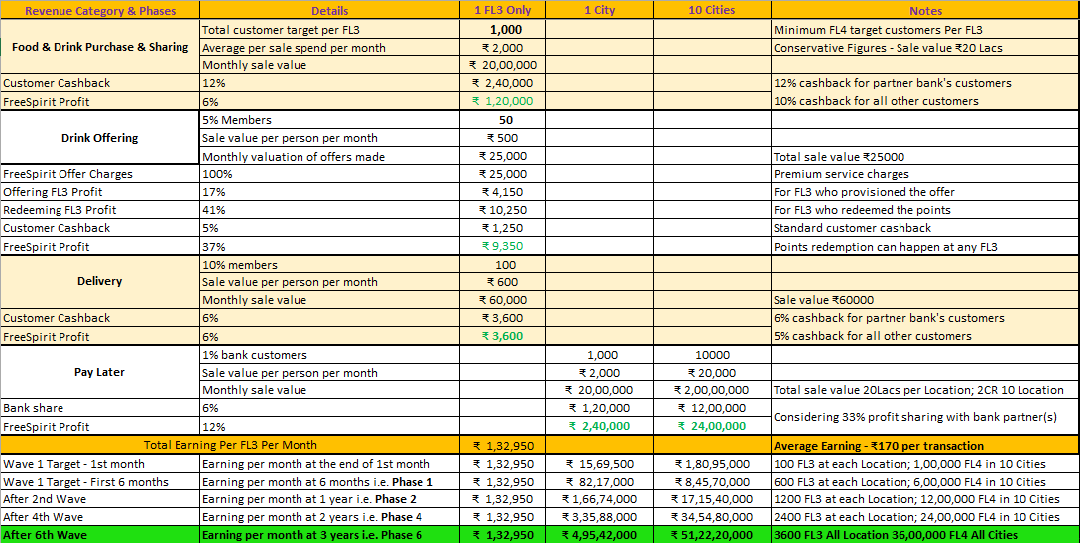
Revenue Model
** Considering pan-India growth opportunities, this model is feasible to sustain for 7-10 years, along with further innovations & industry evolutions

Slide 12
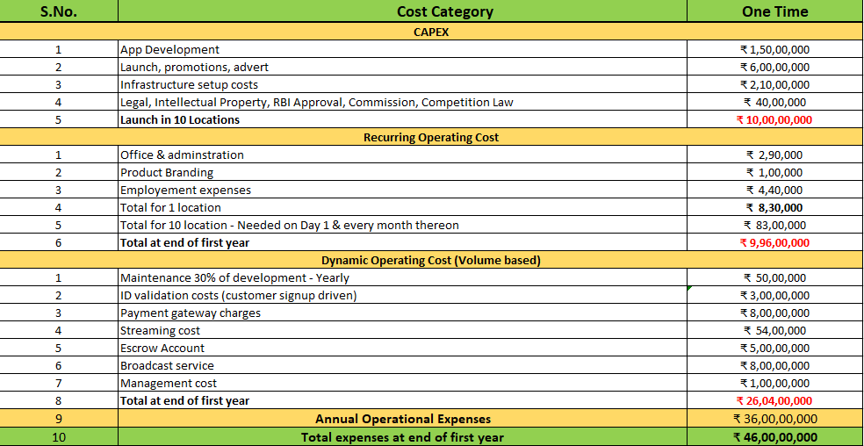
Capital Investment & Operational Expenditure
** Considering pan-India growth opportunities, this model is feasible to sustain for 7-10 years, along with further innovations & industry evolutions

Slide 13
Our Team
Rajesh
Alok
Chetan
Sanjay
Chatur
Chepe
RC Patil
Raju patil
Partners:
KPMG
IRSRD

Slide 14
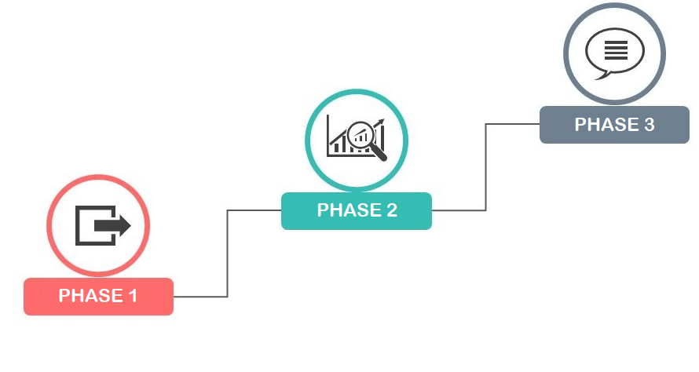
Phased Evolution Plan – Option 1
Overseas launch, Integration with other apps
Restaurant appraisal & consumer rating
SOP standardization & master training
Horizontal expansion of broadcasting
Multi-tier membership with range of features
Data science & analytics, Supply-chain services
Hospitality governance & administration solution
Sponsored Event Services, Corporate Tie-Ups
Pricing diversification, Integration with parallel trending apps
WAIŪ Hangout & personalized theme based offers & events
Confidential and Proprietary. Copyright (c) by TrueVibez 2020

Slide 15

Phased Evolution Plan – Option 2
Overseas launch, Integration with other apps
Restaurant appraisal & consumer rating
SOP standardization & master training
Horizontal expansion of broadcasting
Multi-tier membership with range of features
Data science & analytics, Supply-chain services
Hospitality governance & administration solution
Sponsored Event Services, Corporate Tie-Ups
Pricing diversification, External app integration
WAIŪ Hangout & personalized offers & events
Confidential and Proprietary. Copyright (c) by TrueVibez 2020
15

Slide 16

Pre & Post Pandemic Outlook
Overseas launch, Integration with other apps
Restaurant appraisal & consumer rating
SOP standardization & master training
Horizontal expansion of broadcasting
Multi-tier membership with range of features
Data science & analytics, Supply-chain services
Hospitality governance & administration solution
Sponsored Event Services, Corporate Tie-Ups
Pricing diversification, Integration with other apps
WAIŪ Hangout & personalized offers & events
Confidential and Proprietary. Copyright (c) by TrueVibez 2020
16

Slide 17
Bank Slide
Customer only
Funding
Infra
Nbfc angle – can they do ppi or extend to us?
Overseas launch, Integration with other apps
Restaurant appraisal & consumer rating
SOP standardization & master training
Horizontal expansion of broadcasting
Multi-tier membership with range of features
Data science & analytics, Supply-chain services
Hospitality governance & administration solution
Sponsored Event Services, Corporate Tie-Ups
Pricing diversification, Integration with other apps
WAIŪ Hangout & personalized offers & events
Confidential and Proprietary. Copyright (c) by TrueVibez 2020
17

Slide 18

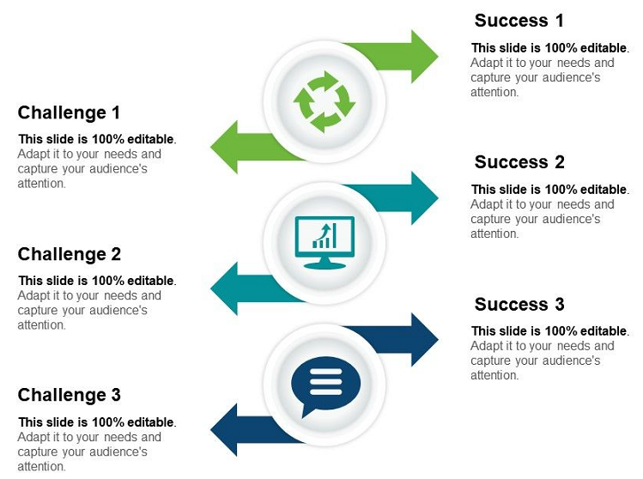
Bank Slide
Overseas launch, Integration with other apps
Restaurant appraisal & consumer rating
SOP standardization & master training
Horizontal expansion of broadcasting
Multi-tier membership with range of features
Data science & analytics, Supply-chain services
Hospitality governance & administration solution
Sponsored Event Services, Corporate Tie-Ups
Pricing diversification, Integration with other apps
WAIŪ Hangout & personalized offers & events
Confidential and Proprietary. Copyright (c) by TrueVibez 2020
18

Slide 19
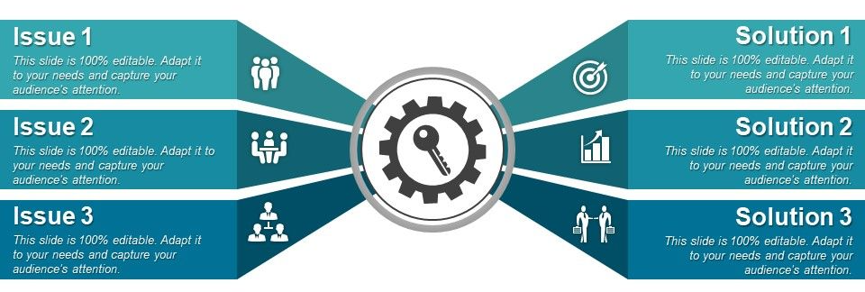
Bank Slide
Overseas launch, Integration with other apps
Restaurant appraisal & consumer rating
SOP standardization & master training
Horizontal expansion of broadcasting
Multi-tier membership with range of features
Data science & analytics, Supply-chain services
Hospitality governance & administration solution
Sponsored Event Services, Corporate Tie-Ups
Pricing diversification, Integration with other apps
WAIŪ Hangout & personalized offers & events
Confidential and Proprietary. Copyright (c) by TrueVibez 2020
19

Slide 20
More ideas
market research in a para for doc - define takeaway
pandameic & post-pandemic slide
banking & resto interaction should be the theme
we take care of the fun part for you, you do the business
we work, you benefit
we selected cosmos out of many other options ilke nbfc
edge over other banks
per sale benefit to be noted - for bank
Overseas launch, Integration with other apps
Restaurant appraisal & consumer rating
SOP standardization & master training
Horizontal expansion of broadcasting
Multi-tier membership with range of features
Data science & analytics, Supply-chain services
Hospitality governance & administration solution
Sponsored Event Services, Corporate Tie-Ups
Pricing diversification, Integration with other apps
WAIŪ Hangout & personalized offers & events
Confidential and Proprietary. Copyright (c) by TrueVibez 2020
20

Slide 21






Question & Answers

Slide 22
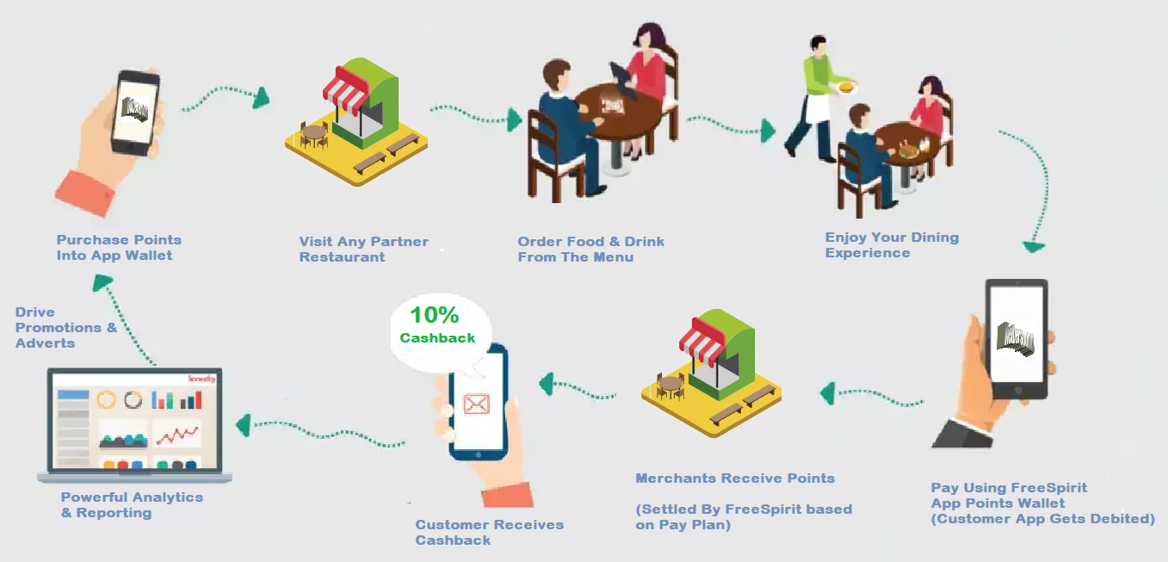
Appendix 1: Indicative Process Flow – Purchase

